Slide 1

MDI1 113: MOBILE APPLICATIONS FOR WEARABLES -
INTERMEDIATE

Slide 2
Cass 1
Class 1: Advanced Movement and Activity Tracking
What is Core Motion?
Understanding Core Motion
Title: Core Motion Framework
Definition:
Core Motion is Apple’s framework for accessing motion data from device sensors.
  Provides access to accelerometer, gyroscope, and pedometer data.
Why Use Core Motion?:
  To track user movement and activity.
  To create motion-driven apps for fitness, navigation, and more.

Slide 3
Cass 1
Sensor Overview
Key Sensors in Core Motion
Accelerometer:
  Measures linear motion and orientation.
  Example: Detecting steps or tilting the wrist.
Gyroscope:
  Detects rotational motion.
  Example: Tracking head movement in VR applications.
Pedometer:
  Tracks steps, walking distance, and activity levels.

Slide 4
Cass 1
Practical Applications
Core Motion in Action
Fitness Apps:
  Track activities like running, cycling, and stair climbing.
Navigation:
  Use sensor data to guide users in the right direction.
Gesture Recognition:
  Enable features like shaking to undo or rotating to zoom.

Slide 5
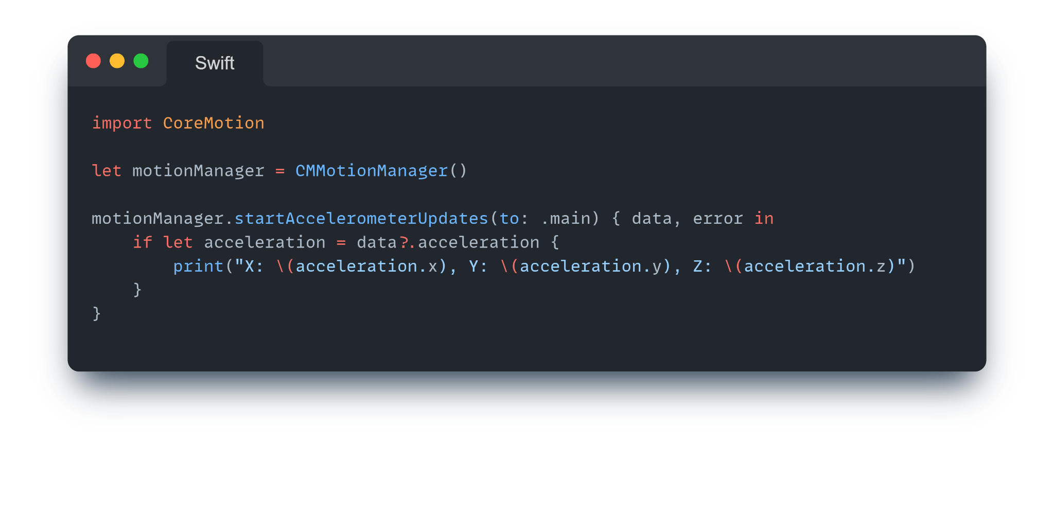
Cass 1
Implementing Core Motion
Example: Capturing Motion Data
Step-by-Step:
  Import Core Motion.
  Initialize a motion manager.
  Start capturing sensor data.
Code Example:

Slide 6
Cass 1
Detecting Patterns
Advanced Motion Detection
Pattern Recognition:
  Combine accelerometer and gyroscope data to detect activities like jumping or squatting.
Real-Life Example:
  A fitness app provides feedback on running posture using motion data.

Slide 7
Cass 1
Challenges in Motion Tracking
Common Issues and Solutions
Challenges:
  Sensor noise: Small, random inaccuracies in data.
  Power consumption: Continuous tracking drains battery life.
Solutions:
  Apply filters to clean noisy data.
  Use batching to process data in intervals.

Slide 8
Cass 1
Class 2: Capturing Images and Media
Wearable Media Capture
Title: Using Wearables for Photography
Capabilities:
  Remotely control a paired iPhone camera.
  Display captured photos/videos on wearable screens.

Slide 9
Cass 1
AVFoundation Basics
Introduction to AVFoundation
What is AVFoundation?
  Apple’s framework for media processing.
  Supports photo/video capture and playback.
Use Cases:
  Enable remote camera control on wearables.
  Capture photos/videos and share them instantly.

Slide 10
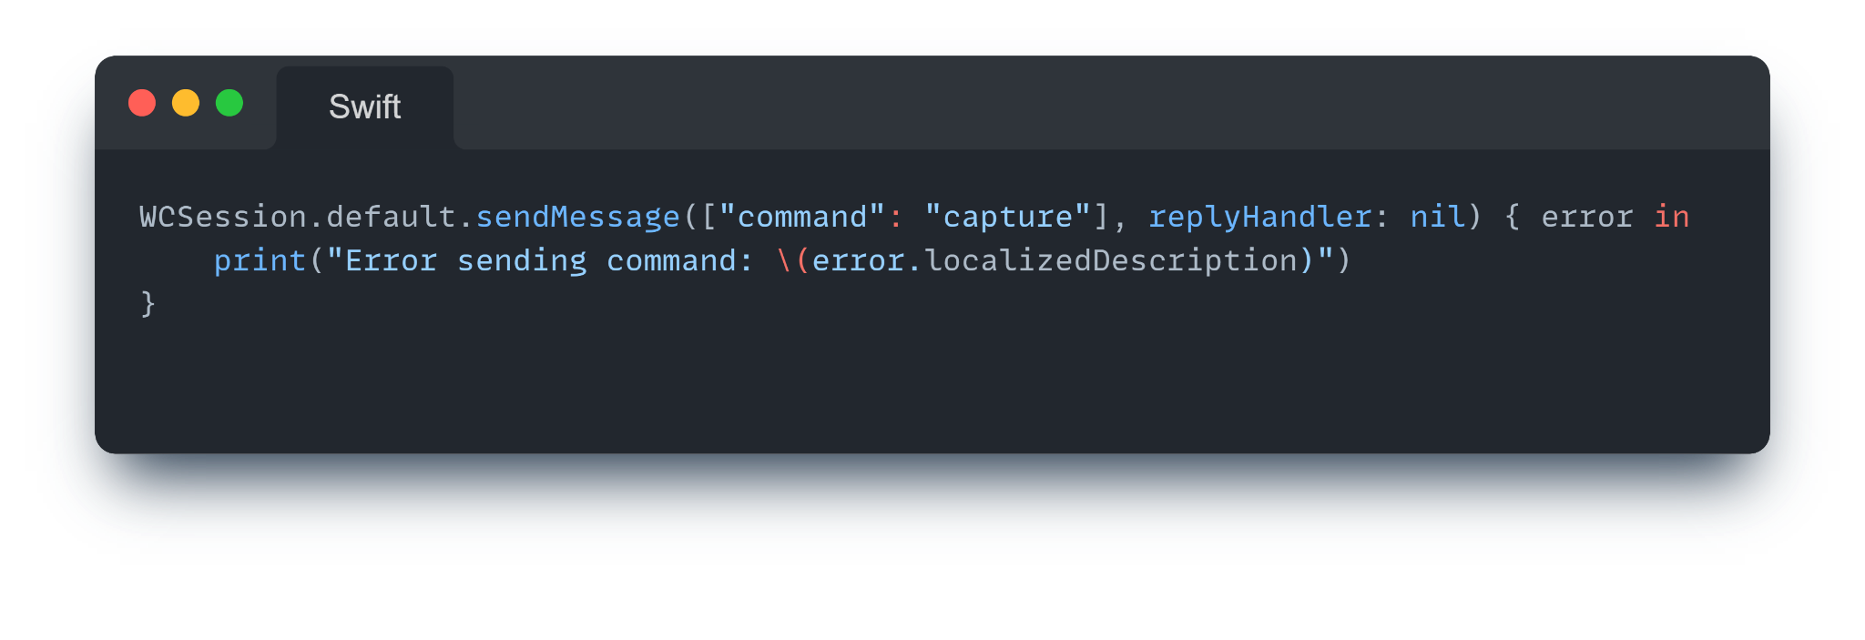
Cass 1
Example Workflow
Capturing Media
Steps:
  Send a command from the wearable using Watch Connectivity.
  Execute the capture process on the paired iPhone.
  Synchronize and display the image on the wearable.
Code Example:

Slide 11
Cass 1
Challenges in Media Capture
Optimizing Media Capture
Challenges:
  Delays in communication between devices.
  Processing limitations on wearables.
Solutions:
  Preprocess media on the paired iPhone.
  Use lightweight image formats for faster display.

Slide 12
Cass 1
Class 3: Monitoring Health Data
What is HealthKit?
Title: Accessing Health Data
Overview: HealthKit is a framework that enables apps to read and write health metrics.
Metrics:
  Heart rate.
  Steps and calories burned.
  Sleep and activity patterns.

Slide 13
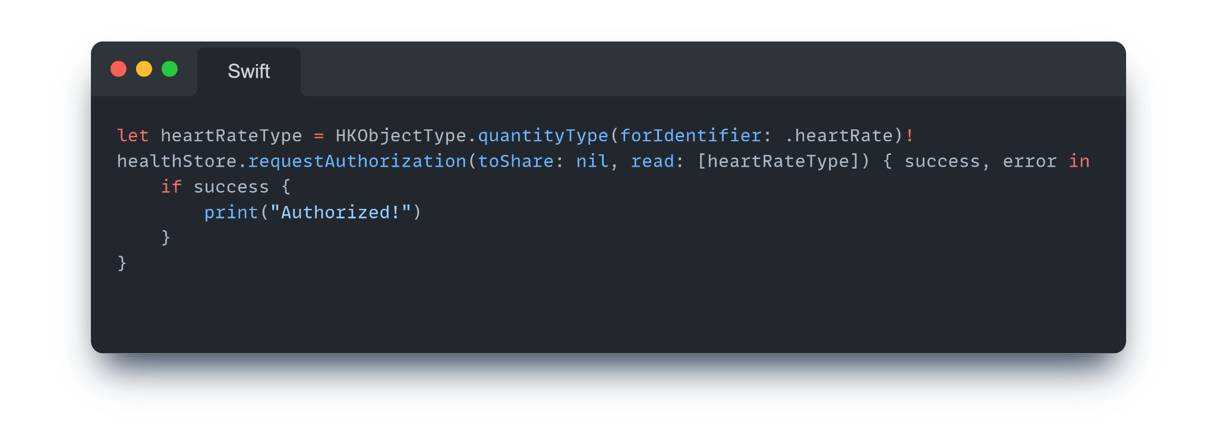
Cass 1
Real-Time Monitoring
Using HealthKit for Live Data
Features:
  Access live heart rate during a workout.
  Track progress toward fitness goals in real time.
Code Example:

Slide 14
Cass 1
Real-Time Monitoring
Using HealthKit for Live Data
Features:
  Access live heart rate during a workout.
  Track progress toward fitness goals in real time.
Code Example:

Slide 15
Cass 1
Challenges in Health Monitoring
Managing Real-Time Health Data
Challenges:
  Handling large data streams efficiently.
  Avoiding unnecessary UI updates.
Solutions:
  Use batching for data updates.
  Notify users only when metrics deviate significantly.

Slide 16
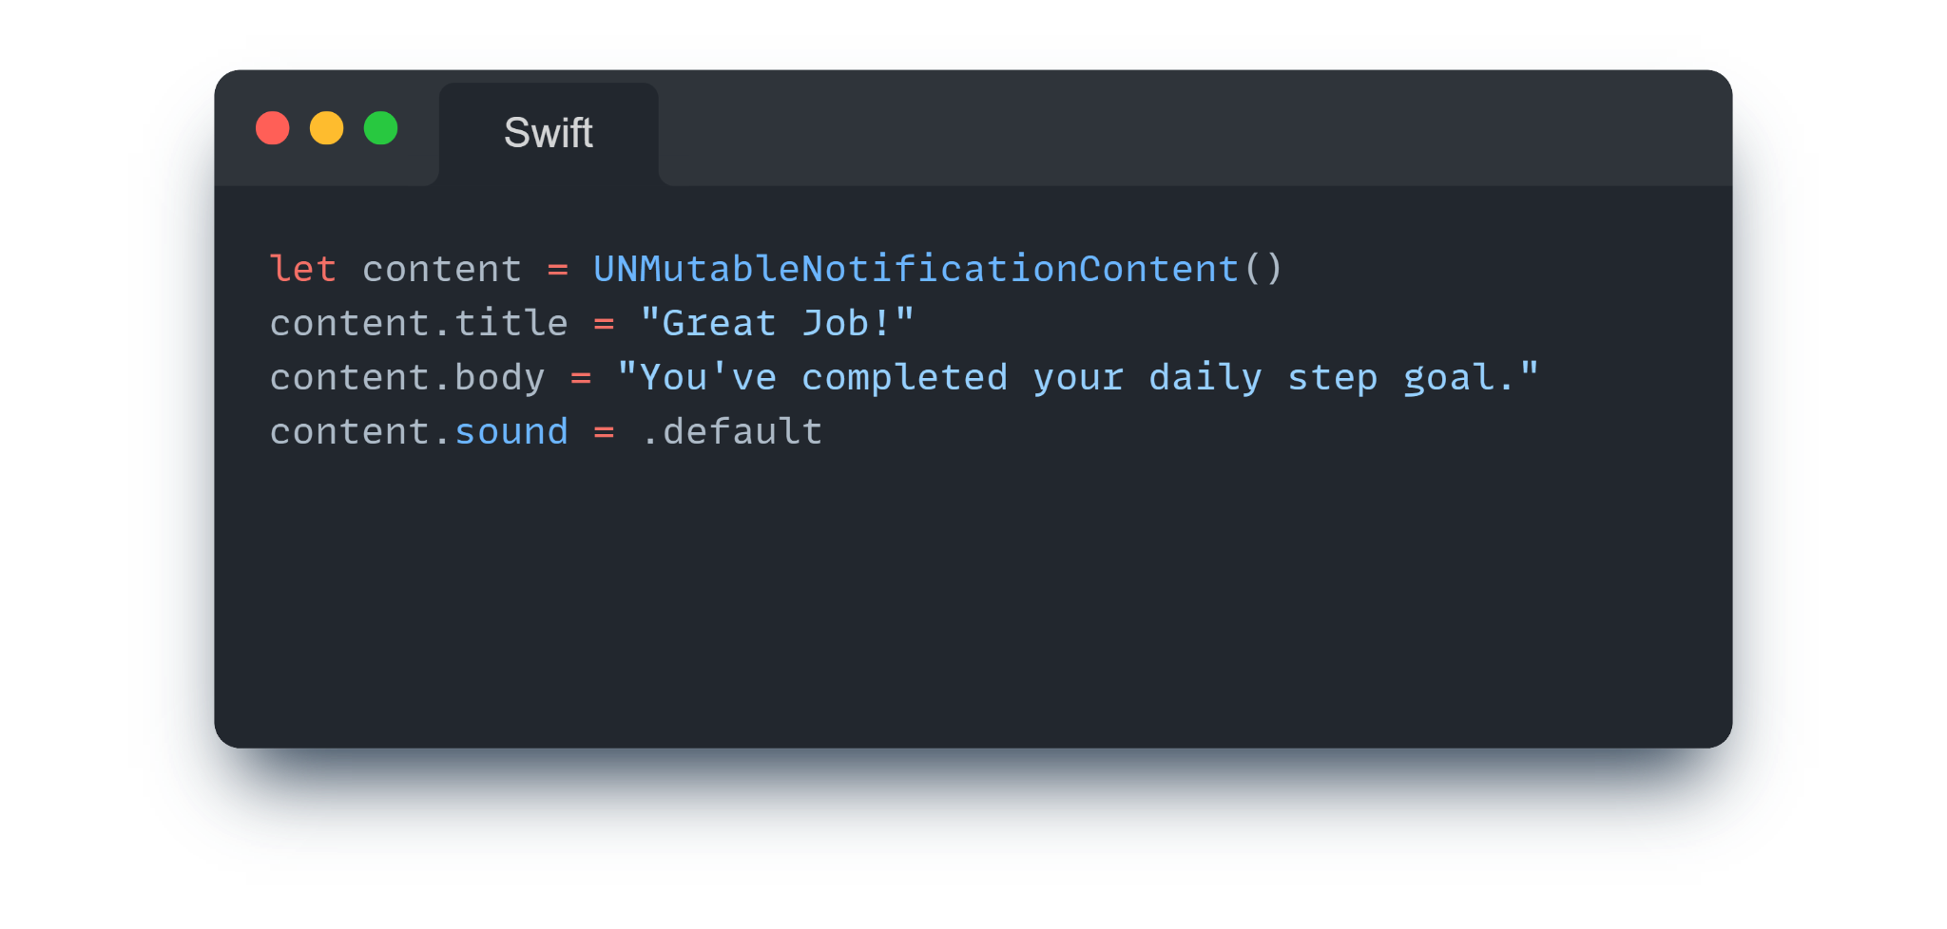
Cass 1
Class 4: Notifications and Feedback
Contextual Notifications
Enhancing Engagement
What Are Contextual Notifications?
  Notifications based on user actions or events.
  Example: Alerting users when they hit a fitness milestone.
Code Example:

Slide 17
Cass 1
Real-Time Feedback Loops
Engaging Users with Feedback
Feedback Types:
  Haptic feedback (vibrations).
  Visual cues (animations).
  Sound alerts.
Examples:
  Vibrating when heart rate exceeds a safe limit.
  Playing a sound when a workout goal is achieved.

Slide 18
Cass 1
Sensor Data Synchronization
Processing and Syncing Data
Key Techniques:
  Batch processing to save power.
  Synchronize with iPhone for complex computations.
Real-Life Example:
  A fitness app processes step counts locally and syncs calorie burn data with the iPhone.

Slide 19
Cass 1
Summary
Key Takeaways:
Mastered advanced movement tracking using Core Motion.
Built skills in capturing and managing media.
Monitored real-time health metrics with HealthKit.
Enhanced user interaction with notifications and feedback.
Optimized wearable applications for power efficiency.

Slide 20
References

